Slide 1



DAV University, Jalandhar
CAR PRICE PREDICTION USING MACHINE LEARNING
45-Day Training in Ai&mL
as3259176@gmail.com
Abhishek Suryavanshi
[12301448] [C04A] [02-12-2025]
Submitted to : Dr.Ridhi Kapoor
GitHub: github.com/suryavanshi1448/12301448
LinkedIn: linkedin.com/in/suryavanshi-abhishek

Slide 2

CONTENT
01
Introduction & Problem Statement
02
Dataset & Data Preprocessing
03
Exploratory Data Analysis (EDA) & Feature Engineering
04
Machine Learning Models & Training
05
Model Evaluation & Results
06
Conclusion & Future Scope

Slide 3
OVERVIEW
Car Price Prediction estimates the selling price of a car using historical data and features like brand, model, year, and mileage. It helps buyers and sellers make fair and informed decisions. In this project, we used a dataset of 50,000 cars from CarDekho and applied machine learning models like Linear Regression, Random Forest, and XGBoost to predict car prices accurately.
01
What is car price prediction?
Car Price Prediction estimates a car’s price using past data and features like brand, year, and mileage, helping buyers and sellers make fair decisions.
02
Why it’s important for buyers/sellers?
Car price prediction helps buyers avoid overpaying and sellers price their cars fairly. It provides data-driven estimates, ensuring competitive and realistic pricing in the market.
03
The problem: price depends on multiple factors.
Car prices vary based on multiple factors: brand, model, year, fuel type, mileage, engine, and condition.
Manual price estimation is time-consuming and often inaccurate.

Slide 4

OBJECTIVES
Objective 1: Data Cleaning & Preprocessing
Objective 2: EDA & Feature Engineering
Objective 3: Build & Evaluate Predictive Models
Data cleaning and preprocessing are essential to ensure the dataset is accurate and consistent. This includes removing duplicates, handling invalid values, and encoding categorical variables.
Exploratory Data Analysis (EDA) helps in understanding the dataset by visualizing patterns and relationships between features and the target variable. Feature engineering transforms/ creates new variables to capture important information.
Building predictive models involves training algorithms like Linear Regression, Random Forest, and XGBoost on the dataset. Evaluating these models using metrics such as RMSE and R² ensures their accuracy.

Slide 5




🛠️ TECHNOLOGIES USED
Data Handling, Analysis
& Visualization:
Pandas – For data loading, cleaning, and manipulation.
NumPy – For numerical and mathematical operations.
Matplotlib – Used for creating plots, charts, and visual analysis.
Seaborn – Heatmaps, pairplots, and statistical visualizations for EDA.
Programming Languages:
Python – Used for data cleaning, EDA, model building, and evaluation.
Machine Learning Libraries:
Scikit-Learn – Linear Regression, Random Forest, preprocessing & evaluation metrics.
XGBoost – Gradient boosting model for advanced predictions.
Tools & Environment
Google Colab – Interactive coding and visualization.
CSV Dataset (CarDekho 50k) – Main dataset for training/testing.

Slide 6


Dataset (Kaggle)
DATASET & DATA PREPROCESSING
Source: CarDekho – 50,000 car listings.
Features: Brand, Model, Year, Fuel Type, Transmission, Mileage, Engine.
Target Variable: Price.
Importance: Large and diverse dataset ensures accurate learning and reliable predictions.
Data preprocessing is critical in machine learning because models can only learn meaningful patterns from clean, well-structured data. Proper preprocessing reduces noise, handles variability, and ensures that all features contribute effectively to the prediction of car prices.
Preprocessing Steps:
Removed duplicates and fixed missing values.
Encoded categorical features (Brand, Fuel Type, Transmission).
Removed outliers to improve model accuracy.
Ensures clean and reliable data for predictions.

Slide 7

EXPLORATORY DATA ANALYSIS (EDA)
Exploratory Data Analysis (EDA) is a critical step in understanding the dataset and uncovering hidden patterns or anomalies. In this project, we analyzed distributions of features such as brand, year, mileage, engine, and fuel type to identify trends affecting car prices. Correlation analysis was performed to determine which features have the strongest relationships with the target variable, price. EDA provides insights that guide feature selection and model development, ensuring that the machine learning models are trained on meaningful data.

Slide 8

FEATURE ENGINEERING
Feature engineering is the process of creating new meaningful variables and improving existing ones from raw data so that machine learning models can learn patterns more effectively. It helps increase accuracy by transforming data into a more useful form.
2nd
4th
Feature Creation & Selection
Testing & Refinement
Created new meaningful features such as car age to improve model learning.
Tested the refined dataset to evaluate model performance and accuracy.
Data collection
Feature Creation
Feature Selection
Testing & Refinement
FUTURE ENHANCEMENTS
1st
3rd
Data Collection
Feature Selection
Gathered CarDekho 50,000 car listings.
Selected the most important features that strongly affect car price.

Slide 9
TRAIN- TEST SPLIT
1. Purpose of Splitting
2. Training Set (80%)
Train-test split helps evaluate the true performance of a model by separating learning data from evaluation data. This ensures predictions are tested on unseen examples.
The training set contains the majority of the data and is used to teach the model patterns such as how features like mileage, age, or brand affect car price. It forms the foundation of the model’s learning.
3. Testing Set (20%)
4. Importance of Splitting
The testing set remains untouched during training and is used only for final evaluation. It checks how accurately the model can predict prices for new car listings.
A proper train-test split prevents overfitting and ensures the model generalizes well. This leads to more reliable and realistic price predictions in real-world use.

Slide 10


STANDARDIZATION/ SCALING
Model Stability Improvement
Training Speed Increase
In machine learning, standardization ensures that all numerical features are brought to a similar scale, preventing any single feature from dominating the model due to larger values.
This improves model stability, speeds up training, and leads to more accurate and consistent predictions across datasets.
95%
80%
Standardizing features using tools like StandardScaler significantly improves model performance.
It helps the model converge faster, reduces errors, and ensures all features contribute equally—resulting in more reliable predictions.

Slide 11
MACHINE LEARNING MODELS USED
A simple and highly interpretable statistical model that establishes a linear relationship between input features and the target variable.
An ensemble of multiple decision trees that reduces overfitting and improves prediction stability through averaging.
Linear Regression
Random Forest Regressor
Regression models predict continuous values, while ensemble methods enhance robustness, accuracy, and generalization across diverse datasets.
A powerful gradient boosting technique designed for high accuracy, efficient computation, and strong performance on structured data.
XGBoost Regressor

Slide 12
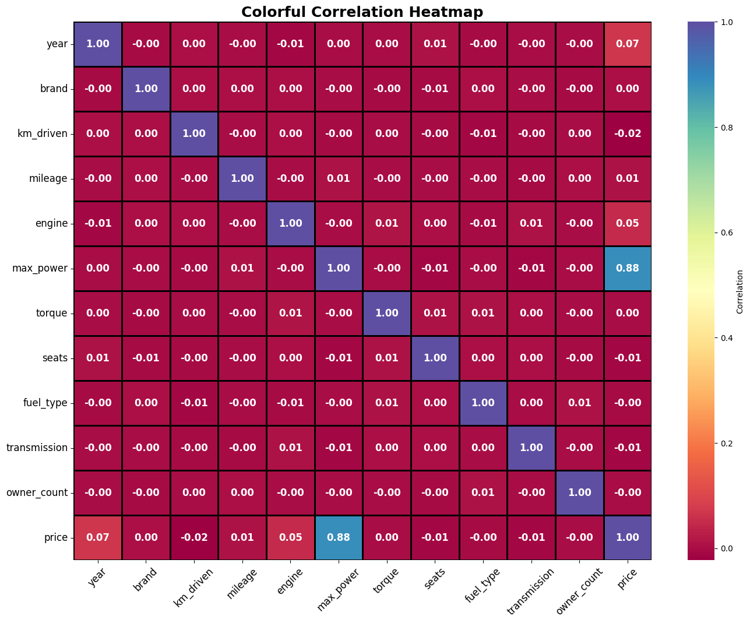
CORRELATION HEATMAP

Slide 13
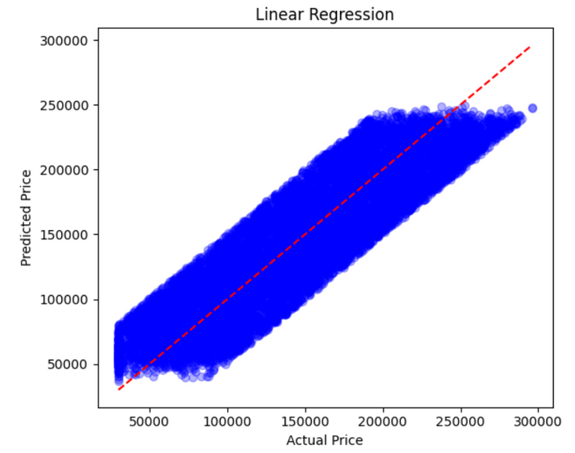
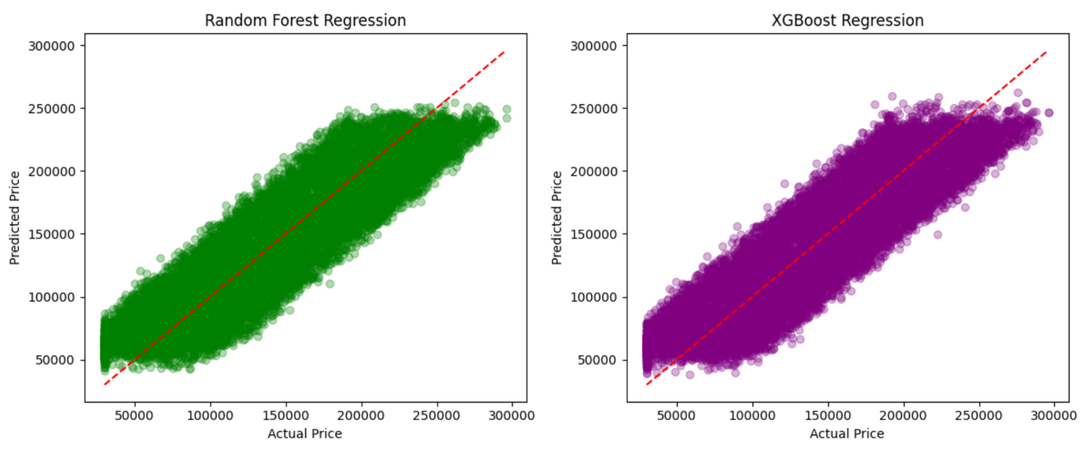
REGRESSION PLOTS: COMPARING MODEL PREDICTIONS
Regression analysis predicts continuous numerical values based on input features. After training models like Linear Regression, Random Forest Regression, and XGBoost Regression, it is important to visually evaluate their performance.

Slide 14
MODEL EVALUATION
R² Score: Indicates how well the model explains variance in the target variable. Higher values → better fit.
RMSE (Root Mean Squared Error): Measures average prediction error. Lower values → more accurate predictions
 | R² Score | RSME
Linear Regression
Random Forest
XGBoost
0.792
28,329
0.784
28,896
0.786
28,776

Slide 15
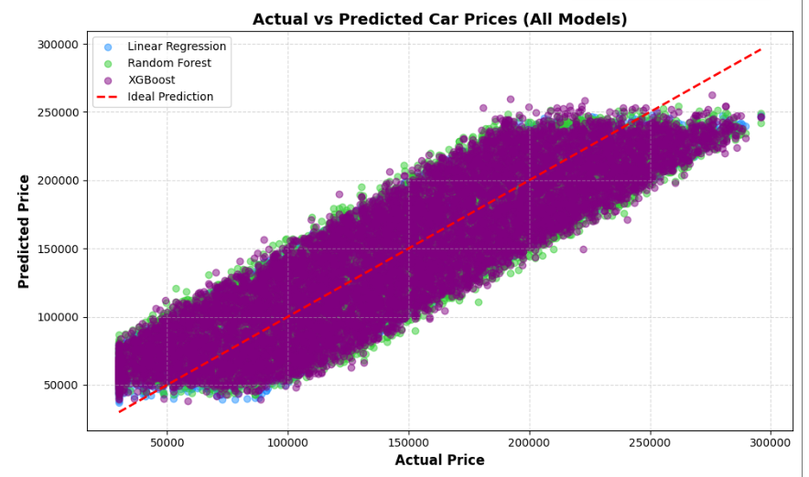
ACTUAL VS PREDICTED CAR PRICES (ALL MODELS)

Slide 16
HIGHLIGHTS
Cleaned and analyzed the CarDekho 50k dataset to predict used car prices, with Linear Regression performing best (R² ≈ 0.79). Future work includes adding more data, extra features, advanced models, and real-time deployment.
Future Scope:
Add more data and include additional features like insurance, car condition, and market trends.
Experiment with advanced models such as CatBoost, ensemble stacking, or deep learning.
Deploy as a web or mobile application for real-time car price predictions.
Apply similar methods to other markets like bikes, electronics, or real estate pricing.

Slide 17
CONCLUSION
Cleaned and analyzed the CarDekho 50k dataset.
Explored relationships between features and car price.
Built models: Linear Regression, Random Forest, XGBoost.
Linear Regression gave the best results: R² ≈ 0.79.
Models can predict car prices reasonably well.

Slide 18



THANK YOU
FOR YOUR ATTENTION
Explore the project and connect!
GitHub: github.com/suryavanshi1448/12301448
LinkedIn: linkedin.com/in/suryavanshi-abhishek

